Slide 1
Elasticsearch

Slide 2
Overview
Full-text search engine with clustering support
Based on Lucene library (http://lucene.apache.org/)
RESTfull interface supporting multiple languages (Java, Python, .Net, Ruby, Javascript atd.)
Use JSON as data format for document definition and commands
Created in 2010 (founder Shay ‘Kimchy’ Banon) by evolution of Compass project (ORM over Lucene), currently in version 5.6

Slide 3
Search concept – inverted index
Star Trek
ID | Token | Document
1 | star | 1,2
2 | war | 2,3
3 | world | 3
Star Wars
War of the Worlds

Slide 4
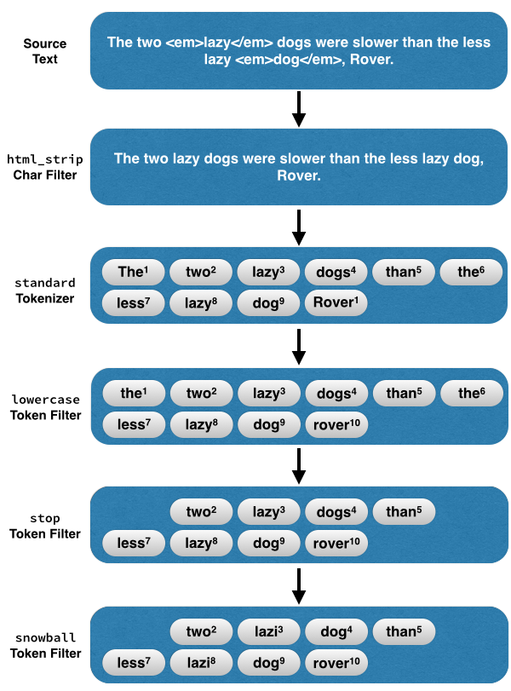
Search concept

Slide 5
Terminology comparison
RDBM
Database
Table
Row
Column
Primary/foreign key relationship
ACID by default
transactions and commiting
Groupping
Elasticsearch
Cluster
Index
Document
Field
Parent/child relationship
NOT ACID
Shard refresh and Translog flush
Aggregations

Slide 6
CRUD
GET/POST/PUT/DELETE {index}
GET/POST/PUT/DELETE {index}/{type}/{id}
POST {index}/{type}/{id}/_update { “doc” : {….} }

Slide 7
Exercise #1
Practice index CRUD operation
Practice document CRUD operation
Practice partial updating
Practice version locking

Slide 8
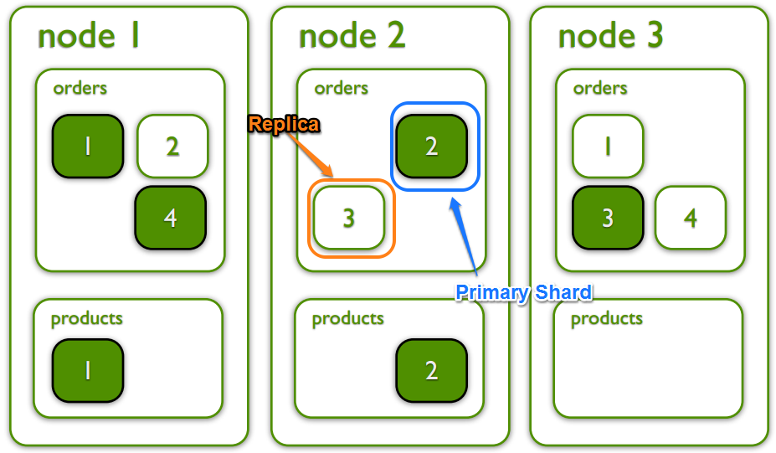
Clustering

Slide 9
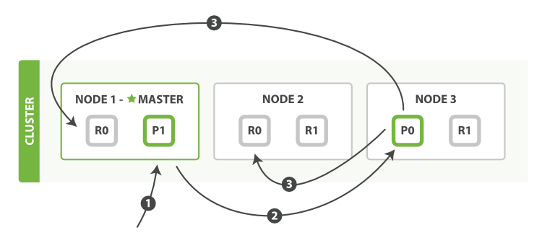
Clustering and shards
https://www.elastic.co/blog/every-shard-deserves-a-home
1. Index request to Node 1
2. Request routed to corresponding primary shard (P0)
3. Request send to replicas once primary is indexed
4. Returning success to Node 1

Slide 10
Cluster health status
Health is determined by the “worst” shard status
Red – at least one index is not complete(shards missing)
Yellow – all primary shards allocated some replicas are not
Green – all shards are allocated
GET /_cluster/health?wait_for_status=yellow

Slide 11
Exercise #2
Run another elastic in your machine
Watch shard distribution when 3rd node appears
Shutdown 2nd and 3rd node
Increase # of replicas
Shutdown 2nd and 3rd node

Slide 12
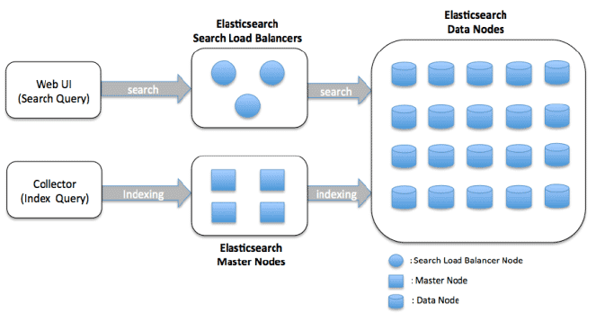
Node types
Data node – storage for Lucene documents.
Search/coordinating node – do not store any data, takes care of requesting other nodes and aggregation of search results
Ingest node – provides pre-processing pipeline for documents
Master node – routes documents for indexing, rebalancing index, handles recovery
Tribe/Cross cluster – “clustered clusters”. Client with ability of searching amongs multiple clusters

Slide 13
Node type configuration
Configuration in elasticsearch.yml
node.master: false
node.data: true
node.ingest: false
search.remote.connect: false

Slide 14
Mapping
Every index has mapping (similar to DB schema)
By default index has dynamic mapping
new fields can be added on the fly
limiting is possible (max fields, depth etc)
explicit mapping is also possible
Mappings can be changed during time (only add/remove)
Fields are shared across multiple index types!!
Types will be deprecated (6.0.0+) and deleted in the future (7.0.0+)

Slide 15
Default fields (meta-fields)
_index- virtual field containing name of index
_type – index type, used in searching by type
_id unique identification in index (_uid compose type and id)
_source – original JSON representing document
_size – size of _source in bytes
_all – “catch all” field that indexes all values from all fields
_field_names – all document fields that does have non-null value
_parent – creates parent-child relationship between two types
_routing – custom routing value which directs document to shard
_meta – application specific field (

Slide 16
Core datatypes
String
text and keyword
Numeric datatypes
long, integer, short, byte, double, float, half_float, scaled_float
Date datatype
date
Boolean datatype
boolean
Binary datatype
binary
Range datatypes
integer_range, float_range, long_range, double_range, date_range

Slide 17
Datatypes settings
coerce – true (default)/false benevolent to different types
boost – float type (1.0) for increase importance in searching
include_in_all – true (default)/false – presence in _all field
Index – true (default)/false – should this field be searched
store – true/false (default)

Slide 18
Datatypes settings
coerce – true (default)/false benevolent to different types
boost – float type (1.0) for increase importance in searching
include_in_all – true (default)/false – presence in _all field
Index – true (default)/false – should this field be searched
store – true/false (default)

Slide 19
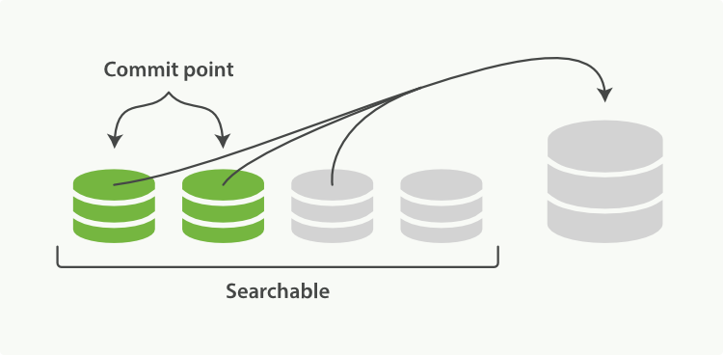
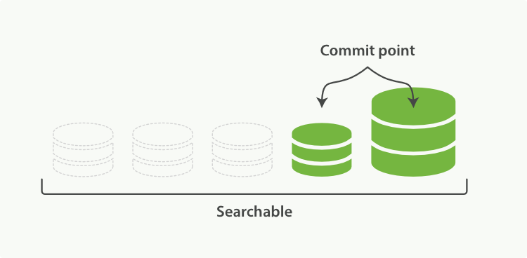
Merging

Slide 20
INSTRUCTIONS FOR USE
EDIT IN GOOGLE SLIDES
Click on the button under the presentation preview that says "Use as Google Slides Theme".
You will get a copy of this document on your Google Drive and will be able to edit, add or delete slides.
You have to be signed in to your Google account.
EDIT IN POWERPOINT®
Click on the button under the presentation preview that says "Download as PowerPoint template". You will get a .pptx file that you can edit in PowerPoint.
Remember to download and install the fonts used in this presentation (you’ll find the links to the font files needed in the Presentation design slide)
More info on how to use this template at www.slidescarnival.com/help-use-presentation-template
This template is free to use under Creative Commons Attribution license. You can keep the Credits slide or mention SlidesCarnival and other resources used in a slide footer.

Slide 21
HELLO!
I am Jayden Smith
I am here because I love to give presentations. You can find me at @username

Slide 22
1.
TRANSITION HEADLINE
Let’s start with the first set of slides

Slide 23
Quotations are commonly printed as a means of inspiration and to invoke philosophical thoughts from the reader.

Slide 24
THIS IS A SLIDE TITLE
Here you have a list of items
And some text
But remember not to overload your slides with content
Your audience will listen to you or read the content, but won’t do both.

Slide 25
BIG CONCEPT
Bring the attention of your audience over a key concept using icons or illustrations

Slide 26
YOU CAN ALSO SPLIT YOUR CONTENT
White
Is the color of milk and fresh snow, the color produced by the combination of all the colors of the visible spectrum.
Black
Is the color of coal, ebony, and of outer space. It is the darkest color, the result of the absence of or complete absorption of light.

Slide 27
IN TWO OR THREE COLUMNS
Yellow
Is the color of gold, butter and ripe lemons. In the spectrum of visible light, yellow is found between green and orange.
Blue
Is the colour of the clear sky and the deep sea. It is located between violet and green on the optical spectrum.
Red
Is the color of blood, and because of this it has historically been associated with sacrifice, danger and courage.

Slide 28

A PICTURE IS WORTH A THOUSAND WORDS
A complex idea can be conveyed with just a single still image, namely making it possible to absorb large amounts of data quickly.

Slide 29

WANT BIG IMPACT?
Use big image.

Slide 30
USE CHARTS TO EXPLAIN YOUR IDEAS
WHITE
GRAY
BLACK

Slide 31
OR USE DIAGRAMS TO EXPLAIN COMPLEX IDEAS
Diagram featured by http://slidemodel.com
Sample Text
Sample Text
Sample Text
Sample Text

Slide 32
AND TABLES TO COMPARE DATA
 | A | B | C
Yellow | 10 | 20 | 7
Blue | 30 | 15 | 10
Orange | 5 | 24 | 16

Slide 33

MAPS
our office

Slide 34
89,526,124
Whoa! That’s a big number, aren’t you proud?

Slide 35
89,526,124$
185,244 users
100%
That’s a lot of money
And a lot of users
Total success!

Slide 36
OUR PROCESS IS EASY
First
Second
Last

Slide 37
LET’S REVIEW SOME CONCEPTS
Yellow
Is the color of gold, butter and ripe lemons. In the spectrum of visible light, yellow is found between green and orange.
Blue
Is the colour of the clear sky and the deep sea. It is located between violet and green on the optical spectrum.
Red
Is the color of blood, and because of this it has historically been associated with sacrifice, danger and courage.
Yellow
Is the color of gold, butter and ripe lemons. In the spectrum of visible light, yellow is found between green and orange.
Blue
Is the colour of the clear sky and the deep sea. It is located between violet and green on the optical spectrum.
Red
Is the color of blood, and because of this it has historically been associated with sacrifice, danger and courage.

Slide 38
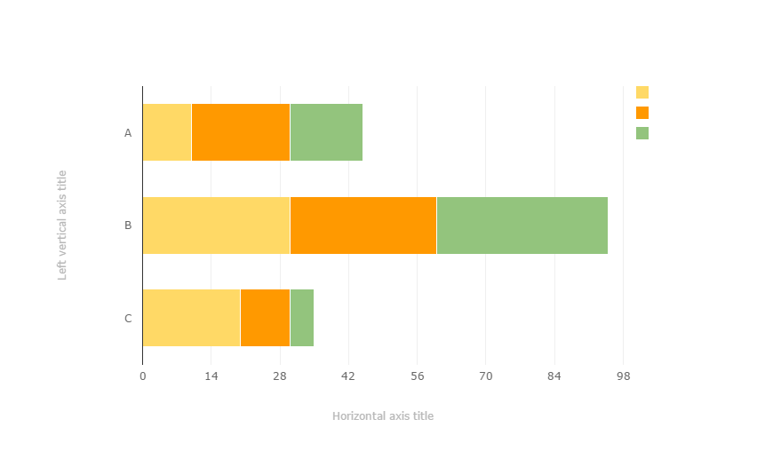
You can copy&paste graphs from Google Sheets

Slide 39
ANDROID PROJECT
Place your screenshot here
Show and explain your web, app or software projects using these gadget templates.

Slide 40
IPHONE PROJECT
Place your screenshot here
Show and explain your web, app or software projects using these gadget templates.

Slide 41
TABLET PROJECT
Place your screenshot here
Show and explain your web, app or software projects using these gadget templates.

Slide 42
DESKTOP PROJECT
Place your screenshot here
Show and explain your web, app or software projects using these gadget templates.

Slide 43
THANKS!
Any questions?
You can find me at @username & user@mail.me

Slide 44
CREDITS
Special thanks to all the people who made and released these awesome resources for free:
Presentation template by SlidesCarnival
Photographs by Death to the Stock Photo (license)

Slide 45

PRESENTATION DESIGN
You don’t need to keep this slide in your presentation. It’s only here to serve you as a design guide if you need to create new slides or download the fonts to edit the presentation in PowerPoint®
This presentations uses the following typographies and colors:
Titles: Montserrat
Body copy: Karla
You can download the fonts on this page:
http://www.google.com/fonts/#UsePlace:use/Collection:Montserrat:400,700|Karla:400,400italic,700,700italic
Click on the “arrow button” that appears on the top right
Red #F44336 Deep orange #FF5722 Orange #FF9800 Amber #FFC107
Yellow #FFEB3B Lime #CDDC39 Green #8BC34A Dark green #4CAF50
Teal #009688 Cyan #00BCD4 Blue #03A9F4 Dark blue #2196F3
Indigo #3F51B5 Deep Purple #673AB7 Purple #9C27B0 Magenta #E91E63
Blue gray #607D8B

Slide 46
SlidesCarnival icons are editable shapes.
This means that you can:
Resize them without losing quality.
Change line color, width and style.
Isn’t that nice? :)
Examples:

Slide 47
😉
Now you can use any emoji as an icon!
And of course it resizes without losing quality and you can change the color.
How? Follow Google instructions https://twitter.com/googledocs/status/730087240156643328
✋👆👉👍👤👦👧👨👩👪💃🏃💑❤😂😉😋😒😭👶😸🐟🍒🍔💣📌📖🔨🎃🎈🎨🏈🏰🌏🔌🔑 and many more...

